Slide 1
Know your Neurotransmitter

Slide 2
Know your Neurotransmitter
With Help From New Officers!

Slide 3
OVERVIEW AND STUFF

Slide 4
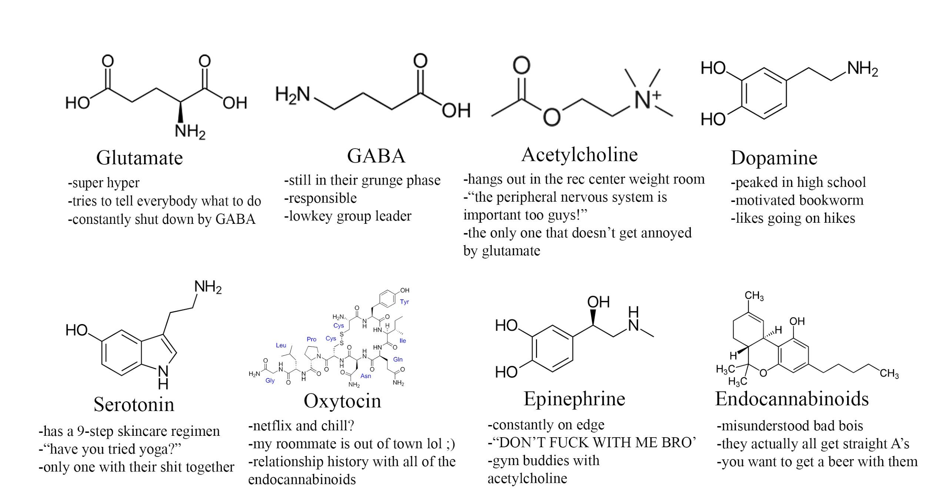
OVERVIEW AND STUFF

Slide 5
General categories that you learn about in psy-220
Amino Acids
Glutamate, GABA

Slide 6
General categories that you learn about in psy-220
Amino Acids
Glutamate, GABA
Gaseous neurotransmitters
NO, CO
Nobody ever talks about these

Slide 7
General categories that you learn about in psy-220
Amino Acids
Glutamate, GABA
Gaseous neurotransmitters
NO, CO
Nobody ever talks about these
Monoamines
Turns out a bunch of the common ones are biochemically connected!
Catecholamine pathway that links a whole buncha common neurotransmitters (Dopamine > Norepinephrine > Epinephrine)
Serotonin

Slide 8
General categories that you learn about in psy-220
Amino Acids
Glutamate, GABA
Gaseous neurotransmitters
NO, CO
Nobody ever talks about these
Monoamines
Turns out a bunch of the common ones are connected!
Catecholamine pathway that links a whole buncha common neurotransmitters (Dopamine > Norepinephrine > Epinephrine)
Serotonin
Peptide neurotransmitters
big
Opioids, Oxytocin

Slide 9
General categories that you learn about in psy-220
Amino Acids
Glutamate, GABA
Gaseous neurotransmitters
NO, CO
Nobody ever talks about these
Monoamines
Turns out a bunch of the common ones are connected!
Catecholamine pathway that links a whole buncha common neurotransmitters (Dopamine > Norepinephrine > Epinephrine)
Serotonin
Peptide neurotransmitters
big
Opioids, Oxytocin
Others
acetylcholine, endocannabinoids

Slide 10
General categories that you learn about in psy-220
Amino Acids
Glutamate, GABA
Gaseous neurotransmitters
NO, CO
Nobody ever talks about these
Monoamines
Turns out a bunch of the common ones are connected!
Catecholamine pathway that links a whole buncha common neurotransmitters (Dopamine > Norepinephrine > Epinephrine)
Serotonin
Peptide neurotransmitters
big
Opioids, Oxytocin
Others
acetylcholine, endocannabinoids

Slide 11

Glutamate & GABA: Two Sides of the Same Coin
Fun fact: this symbol is called the ‘taichi’

Slide 12

Glutamate & GABA: Two Sides of the Same Coin
Glutamate: makes neurons fire more
Jeff Cantle is gonna do a Techniques class fall quarter on CRISPR, hype

Slide 13

Glutamate & GABA: Two Sides of the Same Coin
Glutamate: makes neurons fire more
GABA: makes neurons fire less
Fun Fact: if you commit hard enough to asking random questions, you can get Jeff Carroll spend to spend the entire quarter on a single tangent

Slide 14
Glutamate & GABA: Two Sides of the Same Coin
These two neurotransmitters are everywhere, and because they are the primary sources of excitation and inhibition, they should play a primary role in your mental schemas of neurotransmitter systems.

Slide 15
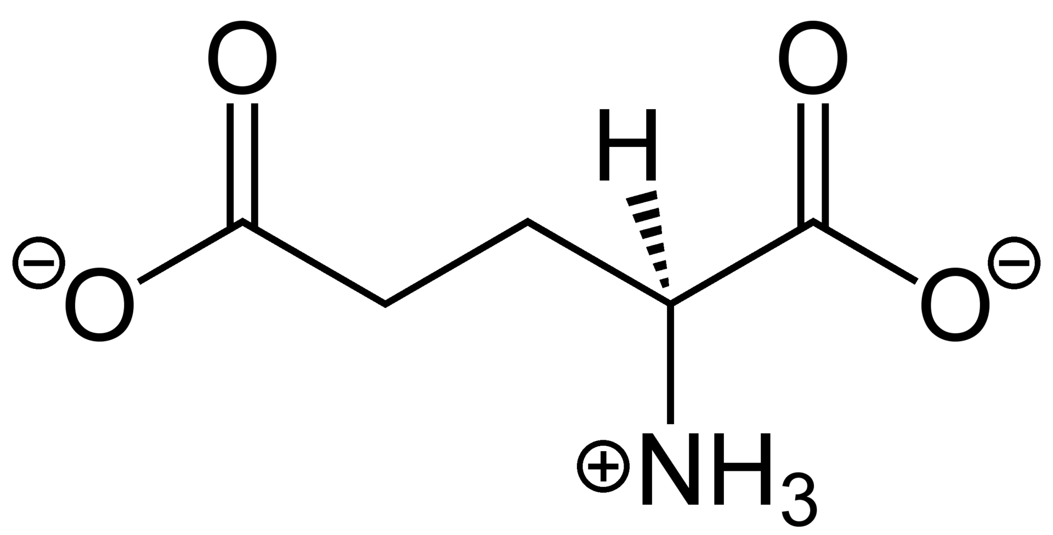
Glutamate

Slide 16
Glutamate
It’s literally just one of the 26 basic amino acids (anionic version of glutamic acid)
super hyper
tries to tell everybody what to do
constantly shut down by GABA

Slide 17
Glutamate
It’s literally just one of the 26 basic amino acids (anionic version of glutamic acid)
Three major classes of receptor
AMPA (lets in calcium / sodium)
NMDA (REALLY cool functionally)
Metabotropic receptors (I know nothing about what these do, so I’m not gonna talk about them ¯\_(ツ)_/¯)

Slide 18
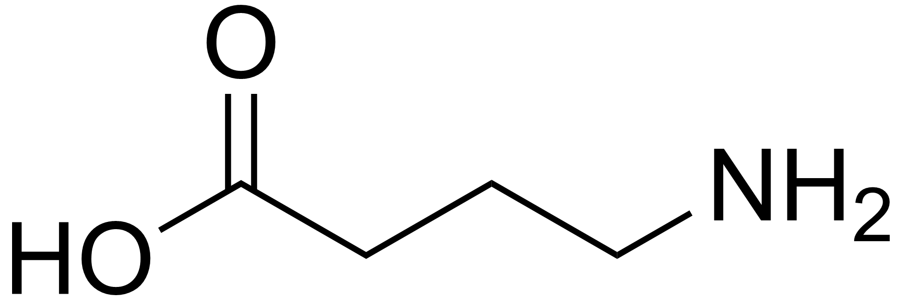
GABA

Slide 19
GABA
Synthesized from glutamate, they’re part of the same biosynthetic pathway
-still in their grunge phase
-responsible
-low-key group leader

Slide 20
GABA
Synthesized from glutamate, they’re part of the same biosynthetic pathway
All over the place
Part of glutamate (the carboxylic acid) just gets chopped off by an enzyme called glutamate decarboxylase to make it

Slide 21
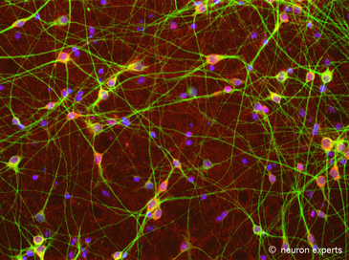
GABA
Synthesized from glutamate, they’re part of the same biosynthetic pathway
All over the place
Seriously, it’s everywhere in the brain
Fluorescently tagged picture of some GABAergic neurons
(circa 2007, colorized)

Slide 22

GABA
Synthesized from glutamate, they’re part of the same biosynthetic pathway
All over the place
Seriously, it’s everywhere in the brain
Think of GABA as the primary neurotransmitter in charge of neural excitability, not glutamate
Electron microscopy picture of GABA inhibiting glutamatergic neurons
(circa 2014, colorized)

Slide 23
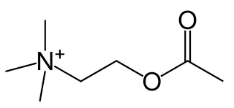
Acetylcholine

Slide 24
Acetylcholine
I lied a bit before about GABA and Glutamate being the most central neurotransmitters
-hangs out in the rec center weight room
-“the peripheral nervous system is important too guys!”
-the only one that doesn’t get annoyed by glutamate

Slide 25
Acetylcholine
I lied a bit before about GABA and Glutamate being the most central neurotransmitters
In muscles, Acetylcholine is king

Slide 26
Acetylcholine
I lied a bit before about GABA and Glutamate being the most central neurotransmitters
In muscles, Acetylcholine is king
Neurons in those ganglia that connect to the peripheral nervous system in the spinal cord are cholinergic

Slide 27
Acetylcholine
I lied a bit before about GABA and Glutamate being the most central neurotransmitters
In muscles, Acetylcholine is king
Neurons in those ganglia that connect to the peripheral nervous system in the spinal cord are cholinergic
REALLY bad if you mess with the Ach system incorrectly

Slide 28
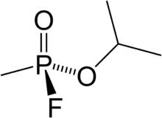
Acetylcholine
I lied a bit before about GABA and Glutamate being the most central neurotransmitters
In muscles, Acetylcholine is king
Neurons in those ganglia that connect to the peripheral nervous system in the spinal cord are cholinergic
REALLY bad if you mess with the Ach system incorrectly
Sarin, which is a nerve gas used in WW1 and which is literally considered a weapon of mass destruction by the UN, acts on acetylcholine receptors to make you go into muscle spasms and quickly become super dead

Slide 29
Acetylcholine
I lied a bit before about GABA and Glutamate being the most central neurotransmitters
In muscles, Acetylcholine is king
Neurons in those ganglia that connect to the peripheral nervous system in the spinal cord are cholinergic
REALLY bad if you mess with the Ach system incorrectly
Nicotinic and muscarinic receptors

Slide 30
Acetylcholine
(It has important roles in the central nervous system too)

Slide 31
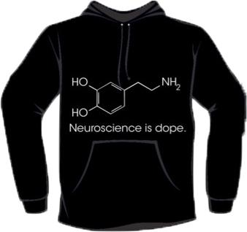
Dopamine

Slide 32
Dope-amine
It’s on your sweatshirt, so you should probably know what it is

Slide 33
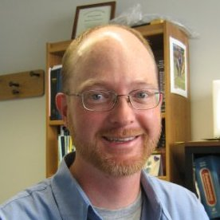
Dope-amine
IT’S NOT ABOUT PLEASURE
was the popular kid in high school
motivated bookworm
likes going on hikes

Slide 34
Dope-amine
IT’S NOT ABOUT PLEASURE
IT’S NOT ABOUT PLEASURE
I once went into Dr. Grimm’s office hours to ask about the DA receptor system and he had no idea who I was and it was really awkward when I realized that

Slide 35
Dope-amine
IT’S NOT ABOUT PLEASURE
IT’S NOT ABOUT PLEASURE
IT’S NOT ABOUT PLEASURE
Signifies the value of a reward
Fortunately he was just excited that someone came into his office to talk about DA, and happily gave me a wonderfully fat review paper to read

Slide 36
Dope-amine
How does this reward value stuff work?

Slide 37

Dope-amine
Monkeys press a lever, then get a reward

Slide 38

Dope-amine
Monkeys press a lever, then get a reward
Dopamine goes up

Slide 39

Dope-amine
Monkeys press a lever, then get a reward
Dopamine goes up
Change the experiment: monkeys only get reward half the time

Slide 40
Dope-amine
Monkeys press a lever, then get a reward
Dopamine goes up
Change the experiment: monkeys only get reward half the time
Dopamine goes WAY up

Slide 41
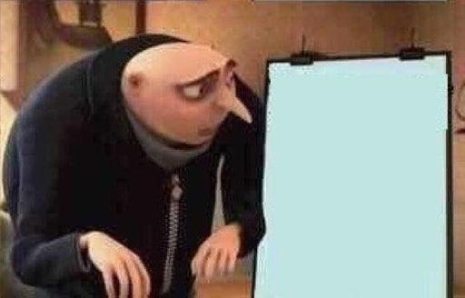
Dope-amine
Monkeys press a lever, then get a reward
Dopamine goes up
Change the experiment: monkeys only get reward half the time
Dopamine goes WAY up

Slide 42
Dope-amine
Crucial insight:
IT SEPARATES SIGNAL FROM THE NOISE
https://www.youtube.com/watch?v=ZIRZu1dRp8Q

Slide 43
Dope-amine
Important structures / pathways

Slide 44
Dope-amine
Important structures / pathways
*some

Slide 45
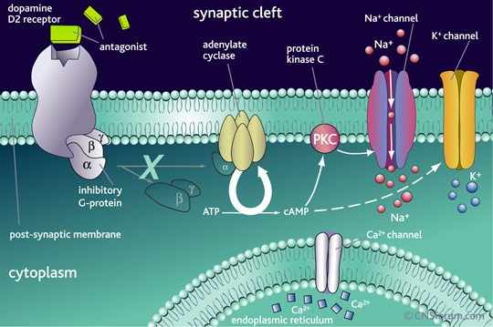
Dope-amine
D1-D5: receptors.
All g-protein coupled
Excitation: D1, D5
Inhibition: D2, D3, D4
Page 1 of Google Image search

Slide 46
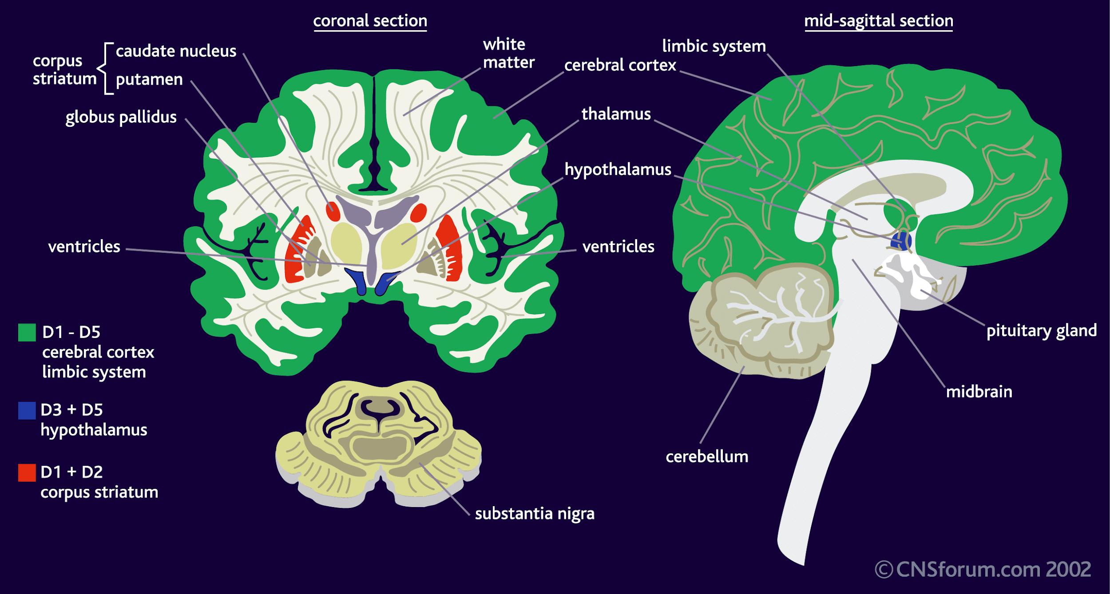
Dope-amine
D1-D5: receptors.
All g-protein coupled
Excitation: D1, D5
Inhibition: D2, D3, D4
VTA, Nucleus Accumbens
#mesocorticolimbic life
Nucleus accumbens shell, core
Motor stuff (Parkinson’s)
“reward”
Still page 1 of Google Image search

Slide 47
OK done with Dopamine

Slide 48
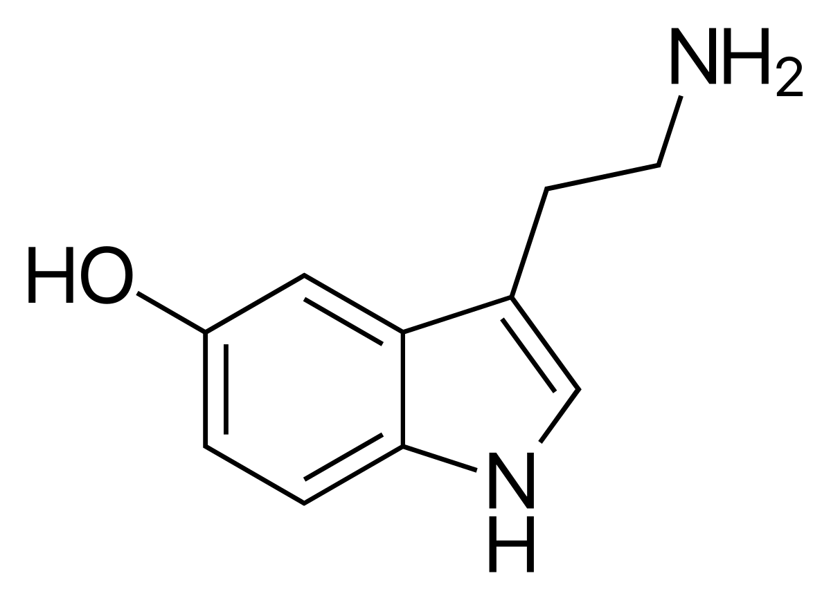
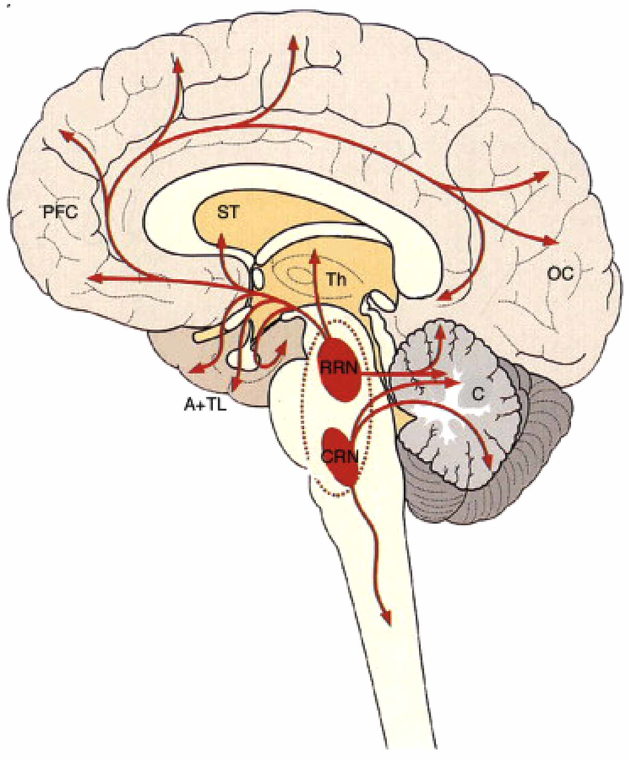
Serotonin
Produced in Raphe nuclei
Involved in mood, cognition, neurodevelopment & neurogenesis, motor control, & nociception
Most receptors of any neurotransmitter
15 separate receptor genes identified
Only one transporter (5-HTT)

Slide 49
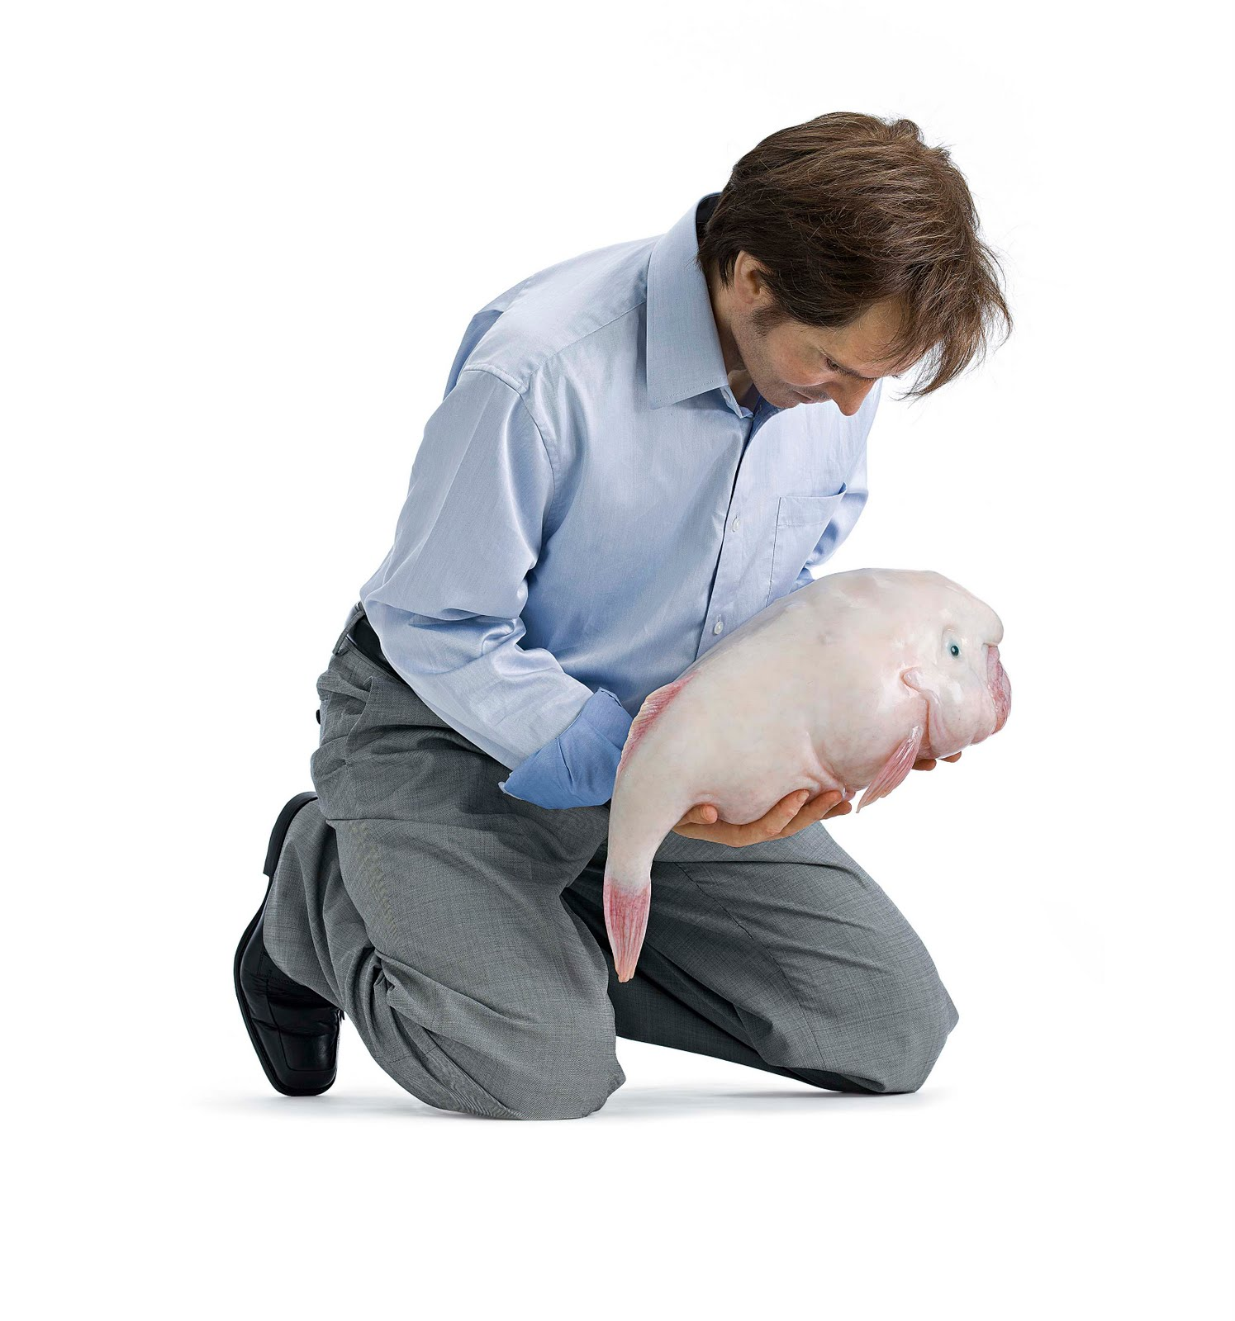
Serotonin
Low levels associated with low affect & mood disorders
Excessive reuptake
5-HTT promoter polymorphism
Results in overexpression of reuptake protein
SSRIs
Selective Serotonin Reuptake Inhibitors
Increase available serotonin
Vitamin D = precursor

Slide 50

Oxytocin

Slide 51
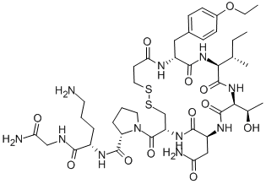
Oxytocin
Love isn’t real

Slide 52
Oxytocin
Love isn’t real
Produced by various peripheral tissues
Uterus, placenta, testes, heart
Released from posterior pituitary gland in response to specific stimuli
Anti-stress effect
Facilitates social bonding
Also necessary for reproduction
Needed for lactation, estrus, childbirth
Also erections and ejaculation in males

Slide 53
Epinephrine

Slide 54
Epinephrine
Secretly adrenaline

Slide 55
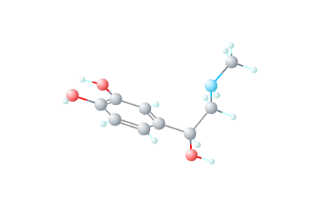
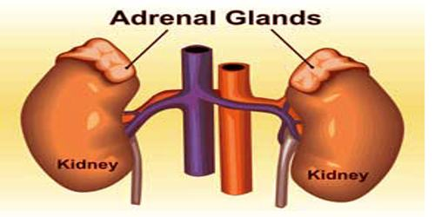
Epinephrine
Secretly adrenaline.
Norepinephrine’s cooler cousin (methyl groups make you cool).
Made by your friendly neighborhood adrenal glands.

Slide 56
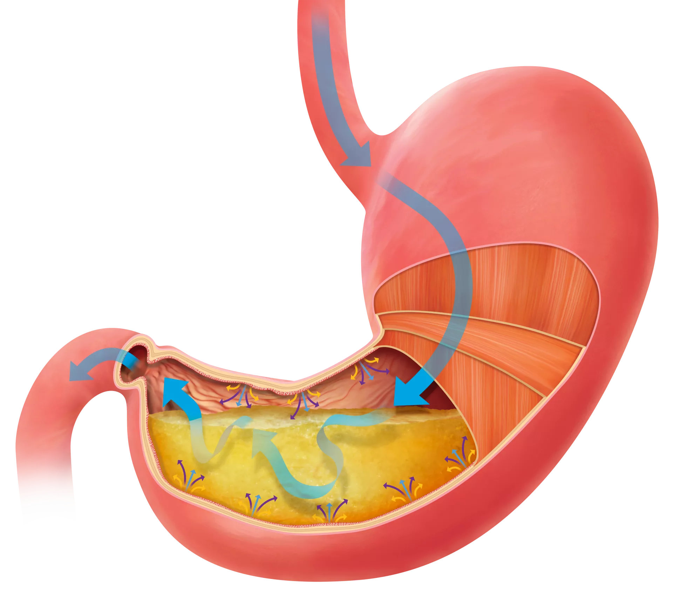
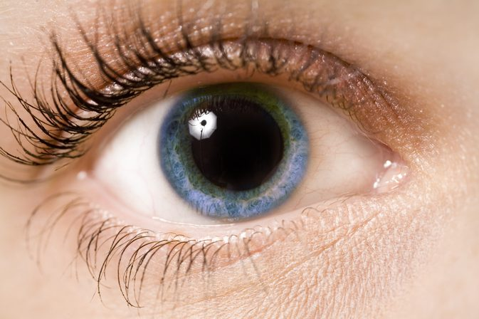

Epinephrine
Secretly adrenaline.
Norepinephrine’s cooler cousin (methyl groups make you cool).
One of the causes for your fight/flight response via arousal of sympathetic nervous system.

Slide 57
Epinephrine-receptor stuff
I know you wanted some more of them metabotropic receptors.

Slide 58
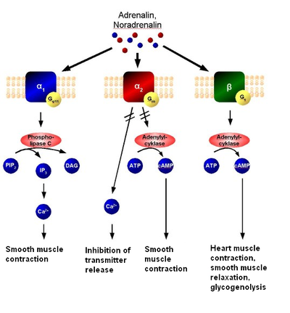
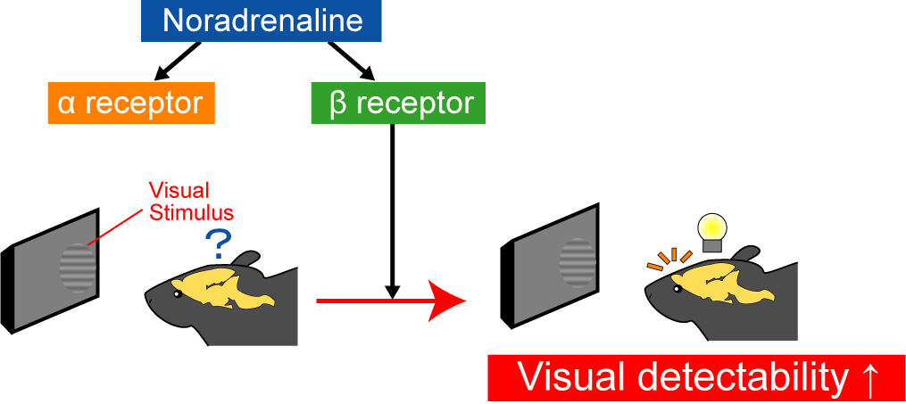
Epinephrine-receptor stuff
I know you wanted some more of them metabotropic receptors.
5 kinds: alpha 1&2, beta 1,2, & 3
Page 1 of Google images part IV

Slide 59
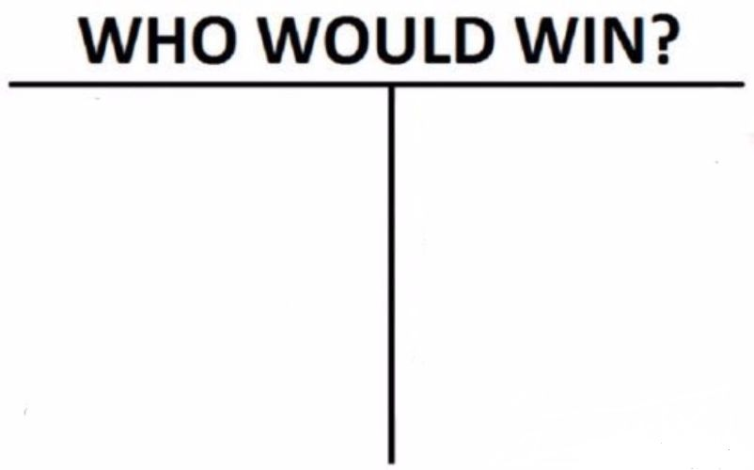
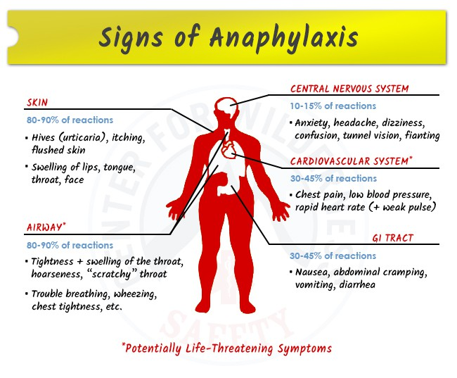
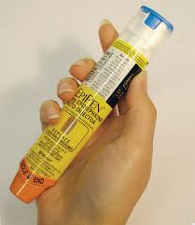
Epinephrine - Medicinal uses
Epipen
Life-threatening anaphylactic shock
One stabby boi

Slide 60
Epinephrine - Medicinal uses
Epipen
Vasoconstriction
Increased blood flow
Bronchodilation
Makes people not die.
Life-threatening anaphylactic shock
One stabby boi

Slide 61
Endocannabinoids

Slide 62
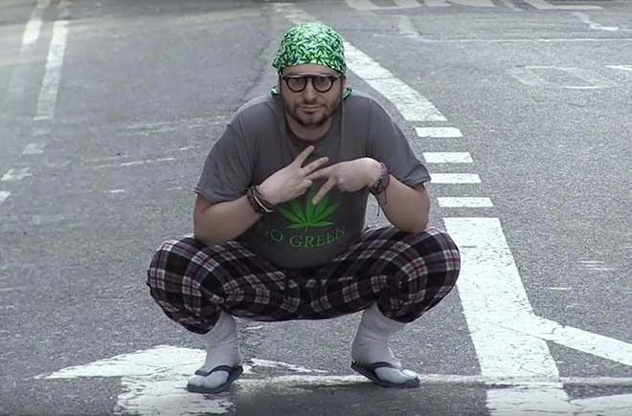
Endocannabinoids
Because we didn’t always know how drugs worked.

Slide 63
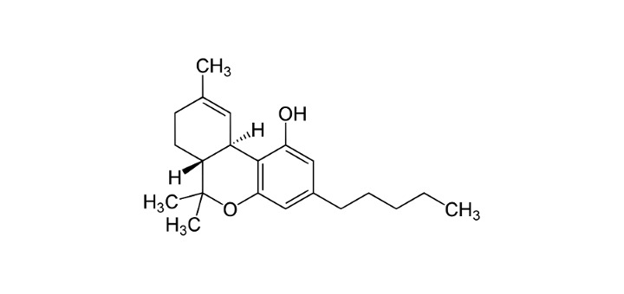
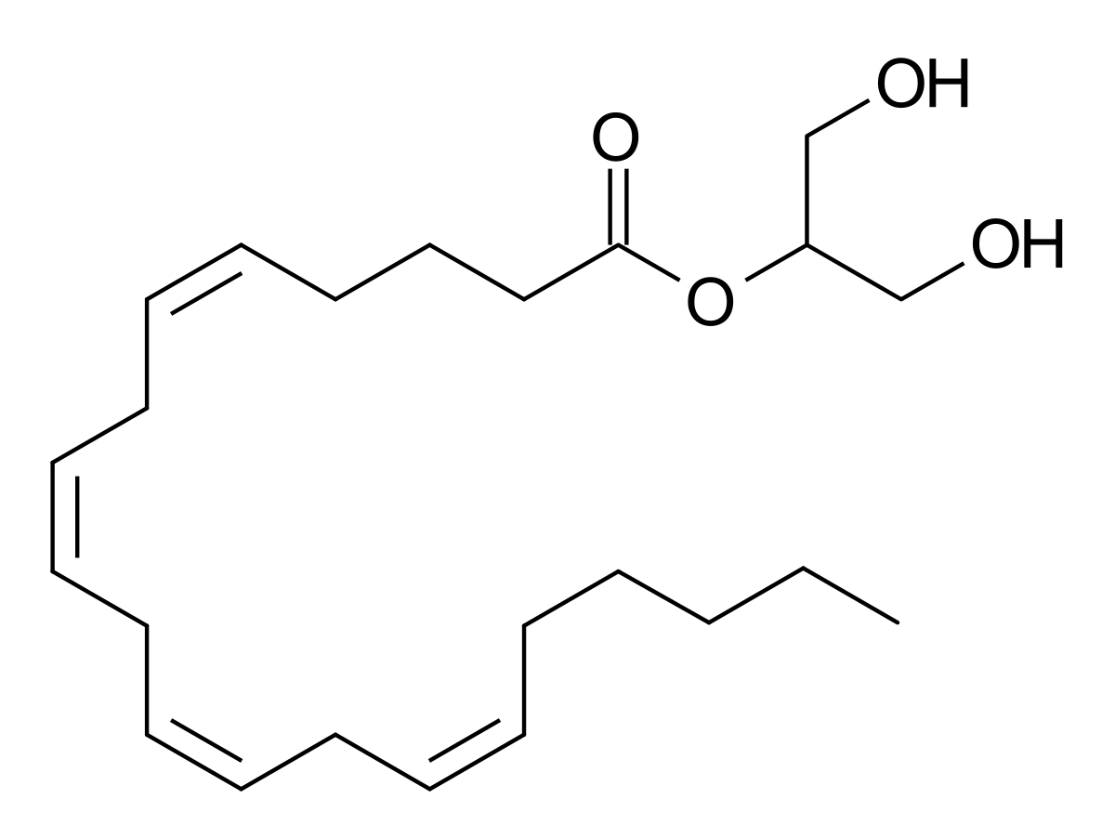
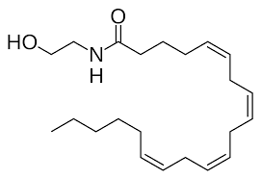
Endocannabinoids
Also the weed drug if you were curious...
Because we didn’t always know how drugs worked.
2-AG and anandamide mainly but there are others.
These are synthesized ON DEMAND from post-synaptic membrane!!

Slide 64
Endocannabinoids
Because we didn’t always know how drugs worked.
2-AG and anandamide mainly but there are others.
3 signal pathways

Slide 65
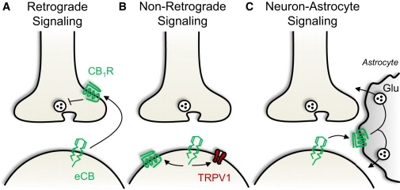

Endocannabinoids
Because we didn’t always know how drugs worked.
2-AG and anandamide mainly but there are others.
3 signal pathways

Slide 66
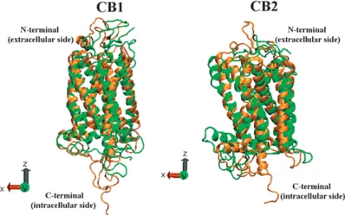
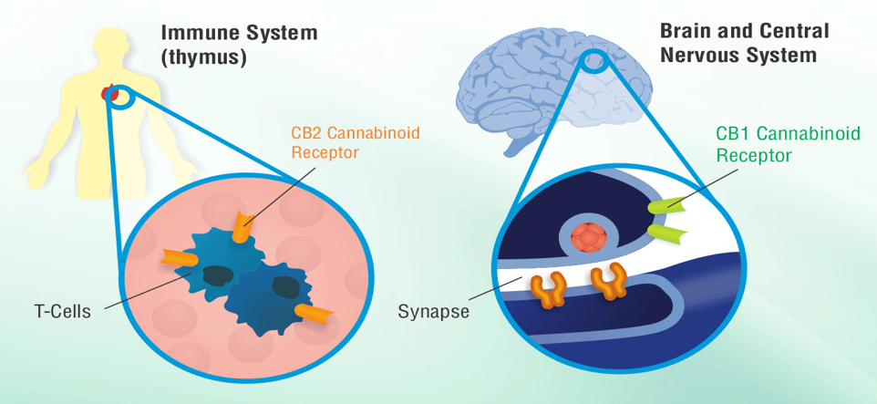
Endocannabinoids
Receptors
CB1 and CB2, but I like CB1 more so that’s what I’ll focus on.
CB2 has roles in the immune system…
THESE BOIS ARE ALL OVER! And are involved in lots of stuff.

Slide 67
Endocannabinoids
Receptors-CB1

Slide 68
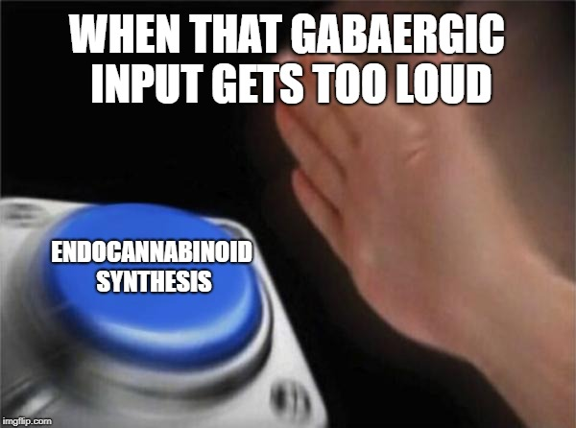
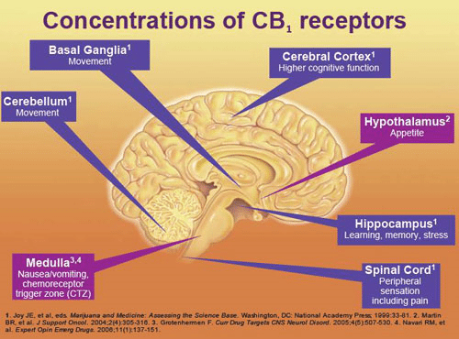
Endocannabinoids
Receptors-CB1
More metabotropic stuff!
CB1 agonists
Inhibit adenylate cyclase (inhibitory effect on the cell)
Close Ca2+ channels (no mas neurotransmitter release)
Open K+ channels (it leaves and more inhibition).

Slide 69
CONCLUSION

Slide 70
CONCLUSION
There are way more neurotransmitters than we talked about here, but these are some of the important ones you’ll hear a lot about

Slide 71
CONCLUSION
Getting a feel for pathways and where they are, and receptor subtypes and what they do, is really helpful for getting a better idea of how and where these all fit together

Slide 72
CONCLUSION
Registration!

